Slide 1

New Models for Understanding and Reasoning about Speculative Execution Attacks
张艺

Slide 2
目录
CONTENTS
01
03
02
04
背景
模型应用
攻击图和安全依赖
结论

Slide 3

01
背景

Slide 4

硬件资源共享
推测性攻击
increases the utilization of resources
preventing a secret from being leaked via shared resources
Out-of-Order execution,
hardware prediction
caching – all essential features
speeding up program execution
Spectre攻击
Meltdown攻击
Speculative Execution
攻击者通过一些操作来训练CPU的BPU
攻击者利用CPU的预测执行把目标的机密数据转移到微架构侧信道中
通过测量Reload内存时间来取出目标机密数据
out-of-order execution
利用乱序执行来访问受限内存
根据所读取到的数值再编码到内存的访问，并通过缓存侧信道提取信息

Slide 5
推广防御策略
provide a new attack-graph model for reasoning about speculative execution attacks.
识别新的攻击方法
。
。
。

Slide 6

02
攻击图和安全依赖

Slide 7

0 Know where the secret is.
2 Authorization
4 Use Secret and Send Secret
1 Set up
3 Secret Access
5 Receive Secret

Slide 8
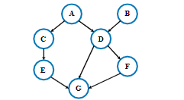
Attack Graph and Races
A vertex in a TSG represents an operation
A directed edge in the TSG represents a dependency of two vertices
A path is a sequence of edges that connects vertices.
Theorem 1. For any pair of vertices u and v, the two
vertices u and v do not have a race condition, if and only
if there exists a directed path that connects u and v.
An ordering of vertices in a TSG is an ordered list that
contains all vertices in the graph S = (v1,v2...vn).
A race condition exists between vertex u and v in a TSG if there exists two different valid orderings S1andS2such that u is before v in S1, and v is before u in S2.

Slide 9

03
模型应用

Slide 10
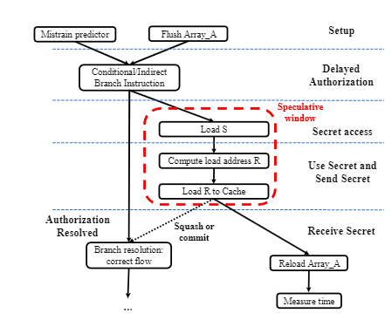
Example: Spectre v1 Attack
Authorization Operations
Sender’s Secret Access Operation
Sender’s Send Operation
Receiver’s Secret Access Operation
数据依赖？
控制依赖？
A security dependency

Slide 11
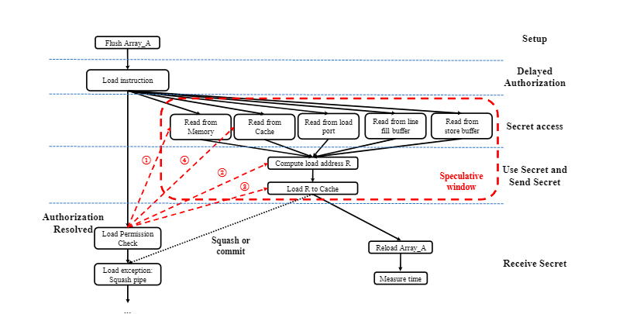
Example: Meltdown Foreshadow MDS
Attack graph model for the Meltdown, Foreshadow and MDS attacks.

Slide 12
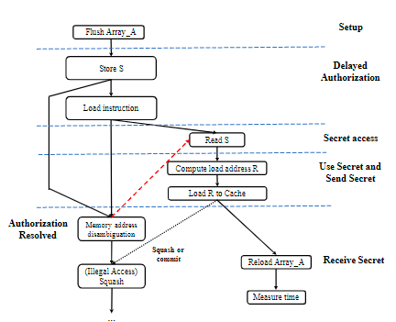
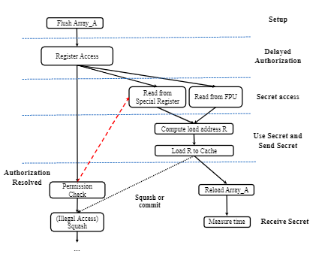
Example : Other Attacks
TSG model of special register triggered attacks
TSG model of memory disambiguation triggered attack

Slide 13

04
结论

Slide 14



1
2
3
Finding New Attacks
Identifying Defense Strategies
Tools for Constructing Attack Graphs
Prevent Access before Authorization
Prevent Data Usage before Authorization.
Prevent Send before Authorization.
Clearing Predictions
finding new sources
of secrets, new exploitable hardware features for delaying Authorization
new covert channels.

Slide 15
THANKS
张艺

